Slide 1
Improving the Tracking System within FishVR
Team: Adam Green, Mohsen Alizadeh Noghani, Matthew Loewen
Notes:
Matt

Slide 3
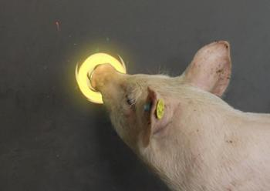
What is it?
Fish tracking with VR
Animal computer interaction
Design feedback loop - real fish + virtual predator
Core of the project:
Visual stimulation -> what happens to movement?
Can this be controlled? predicted?
https://michellewesterlaken.com/2013/03/12/animal-computer-interaction-on-national-tv/
Notes:
Matt

Slide 4
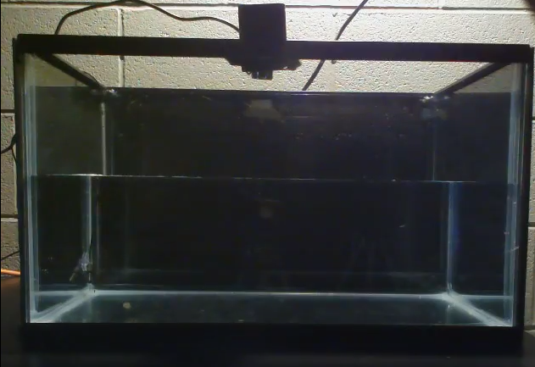
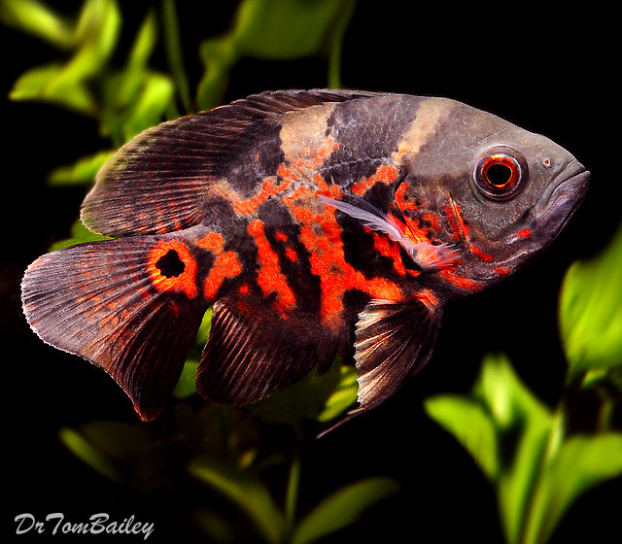
Why? - Background
To facilitate behavior experiments with virtual simulations
Maintain a healthy experimental specimen
Simulate real environment within a lab
Designing a training toolkit
Want to measure:
Fish individual + social lives
Natural vs virtual behavior
Impact of well-being
Notes:
Matt - Red African Cyclid

Slide 5
Existing tech
Most are rudimentary, non-adaptive, and not automated, resulting in significant drawbacks when estimating behavioral responses.
Basically - design an automated, self-evolving system to carry out unsupervised testing.
Notes:
Matt

Slide 6
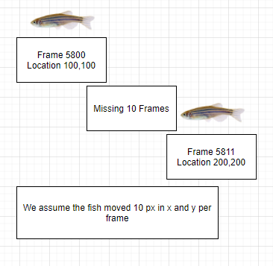
Pre-this class
Missing information
Mapping real world space to pixels
20” length x 10” width x 12” height - converted to 2 480 x 640 videos
In the case of missing tracking an average of the last detection + current detection will be used to fill in missing points
More sophisticated gap-filling techniques.
Notes:
Matt

Slide 7
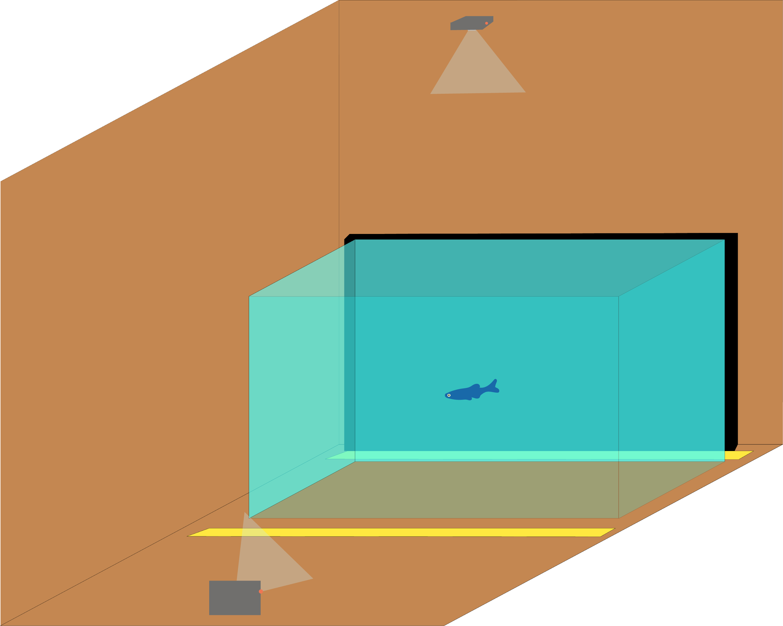
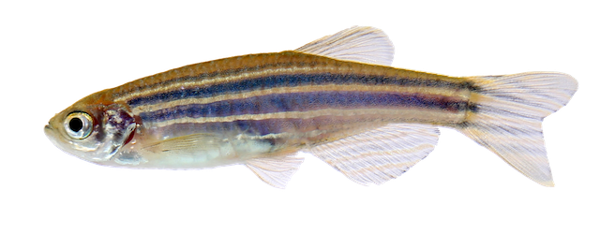
Our Materials
Covid = Lack of data & time
Fish tank with fish
Funding delay for fish/camera setup
Cameras pointing in two cartesian directions at the tank
Notes:
Matt

Slide 8
Previous Implementation
Frame-differencing technique
OpenCV module Python
Lossy, will not function with camera instability
Picks up shadows/reflections (can be somewhat resolved with lens filters)
Loses the target 20/25% of the time
Only reports center of fish (issues of overlap)
Vibrations (someone walking) ruins tracking
Ok for short tracking sessions
Terrible for long tracking sessions
Not scalable
Notes:
Matt

Slide 9

Frame-Differencing Demo

Slide 10
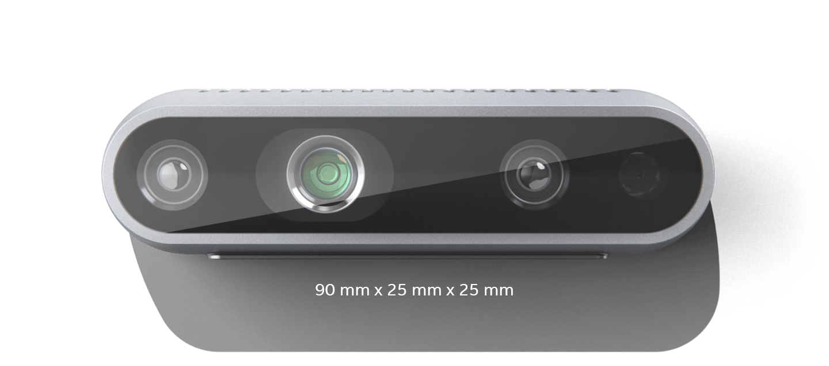
Potential: IR Camera for Tracking
IR Camera for recording fish movement
Decided to opt for simplicity with the two-camera setup
Delay in funds - wouldn’t have IR camera in time
Depth sensing with IR technology
Intel RealSense D435
Notes:
Adam

Slide 11
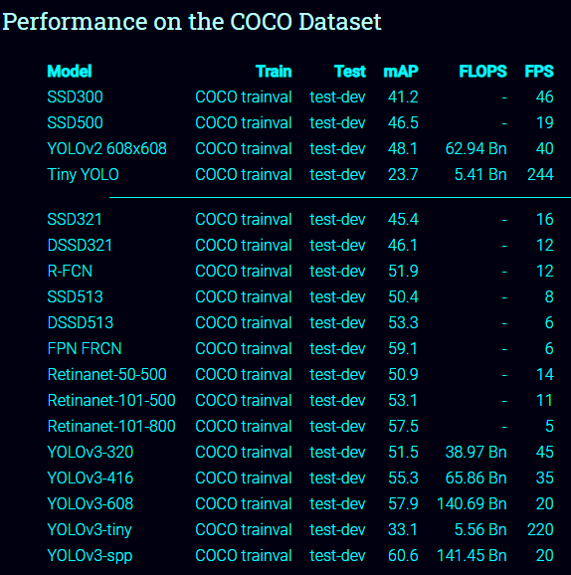
Our Solution: CNN to recognize fish
We decided on utilizing a CNN to recognize and track the fish as opposed to the frame-differencing technique
YOLOv3 (read more: https://pjreddie.com/darknet/yolo/)
You Only Look Once
Original source code: https://github.com/ultralytics/yolov3
Our YOLOv3 model functions at between 30-60 FPS
Tradeoff between mAP and FPS
Notes:
Adam

Slide 12
Training: Using Pre-trained weights
ultralytics/yolov3 came with pretrained weights on the COCO dataset (80 common objects)
None of the detection classes matched with our target (zebrafish)
We had to train the network on our custom dataset
Notes:
COCO - Common Objects in Context
Adam

Slide 13
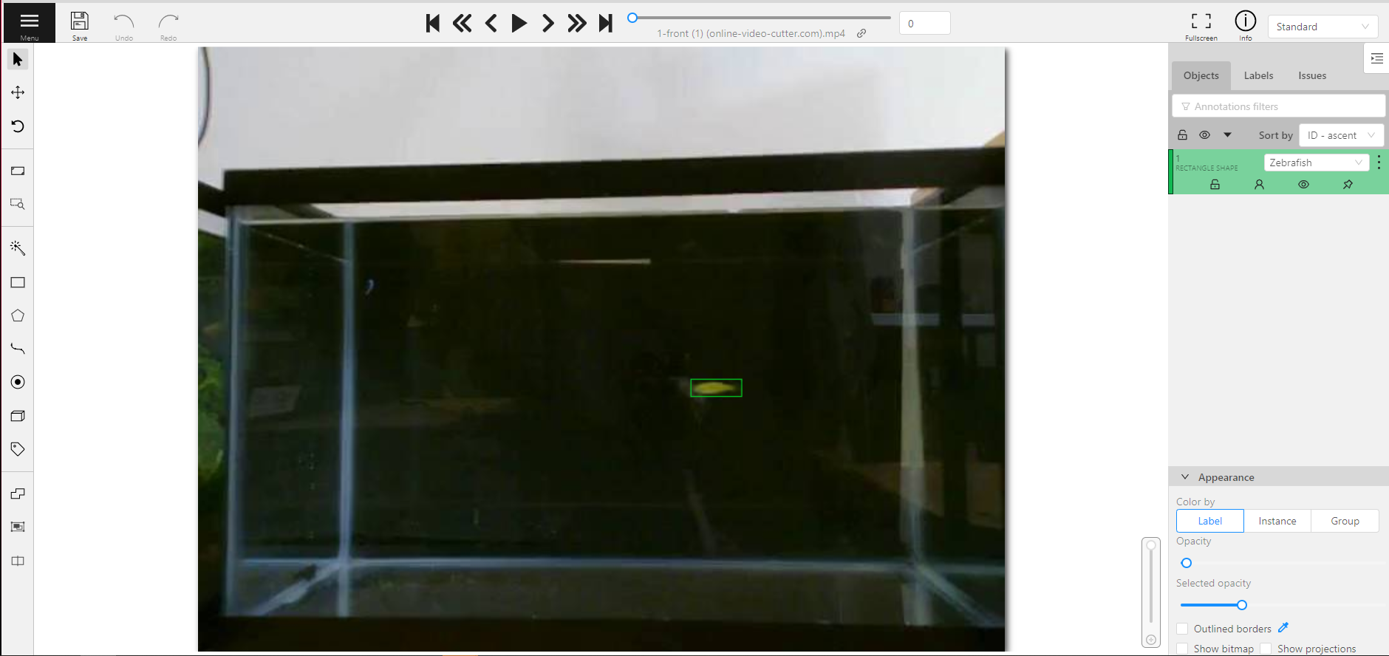
Training: Labeling
Hand-labeled data from fish
Low resolution leads to some issues in detection, manual gap filling.
Trained the network with 2,265 images
Trained for 5 and then 80 epochs
Used CVAT to label images (cvat.org)
Computer Vision Annotation Tool
https://github.com/openvinotoolkit/cvat
Supports YOLOv3 annotation and data export
cvat.org GUI
Notes:
Adam

Slide 14
Training: Results
We had issues with data acquisition due to the fish dying,
Had to use low-resolution videos (480x640)
Originally 1080p videos, but the videos were too large to upload to Google Drive
In the future, will have to retrain on higher resolution videos as the features will probably not match up correctly
Results for training 80 epochs:
Took ~3 hours 6 minutes
Training 5 epochs took 0.64 hours (38.4 minutes)
Batch size: 8, image size: 480x640
Nvidia GeForce RTX 2080 Super
Almost overheated (computer case was too hot to touch)
Notes:
Adam

Slide 15
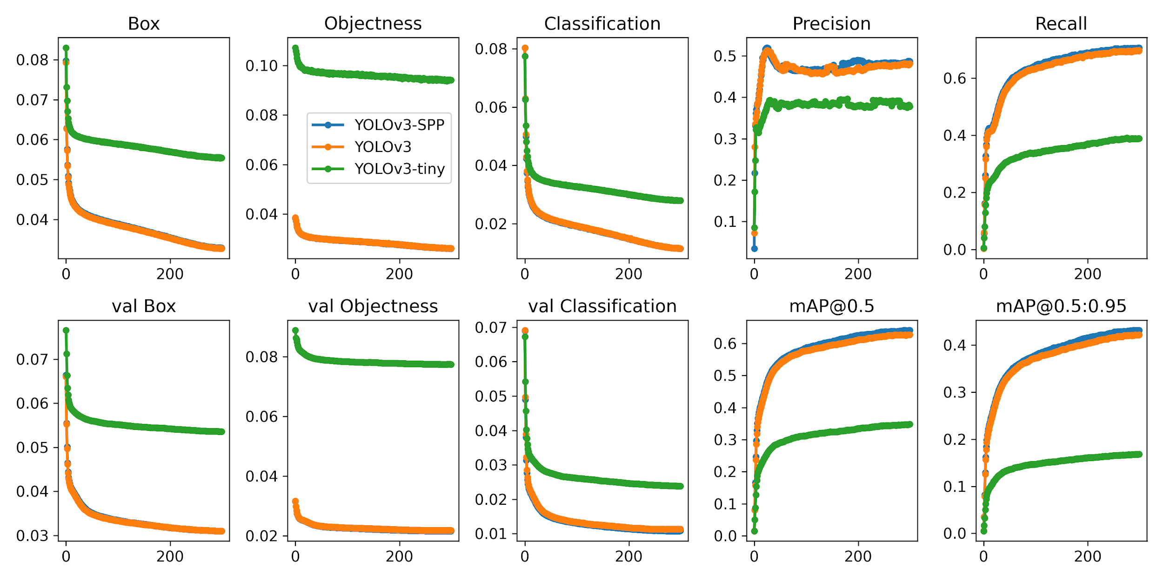
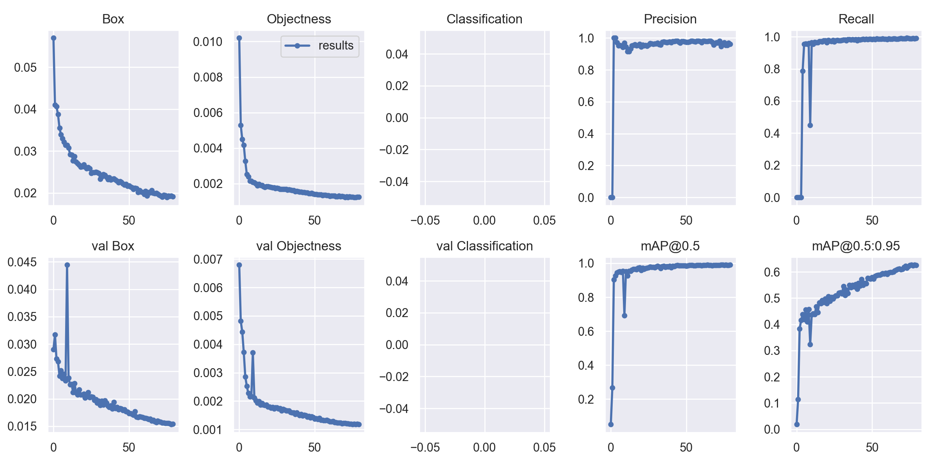
Training Results
Add what each of these criteria mean and which one is most important.
Results presented on the Github repository
Batch size = 24, Tesla V100
80 epochs
Notes:
MAP = mean average precision
Adam

Slide 16
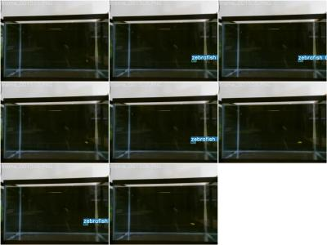
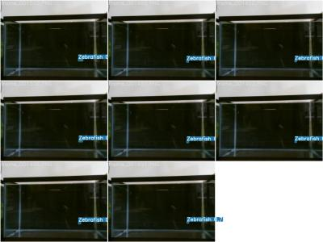
Network Predictions
5 epochs
80 epochs
Notes:
Adam

Slide 17
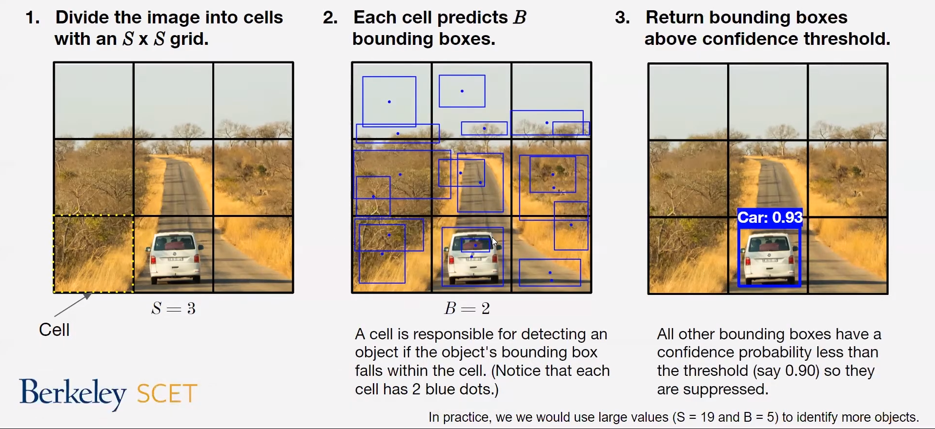
More about YOLO
Pass an entire image to a CNN. Outputs: Label, Bounding box info, confidence for each object in the image.
Source: YOLO Object Detection (Part 1), Berkeley DataX Lab
Notes:
Mohsen

Slide 18
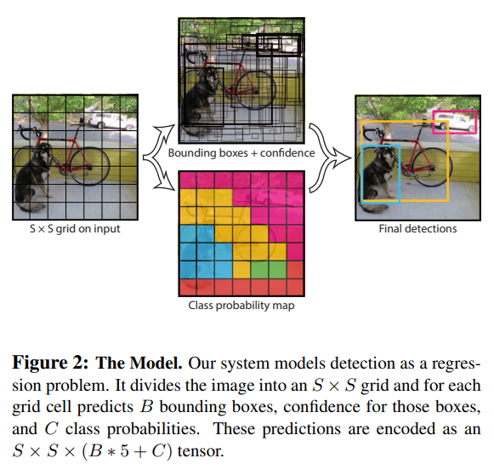
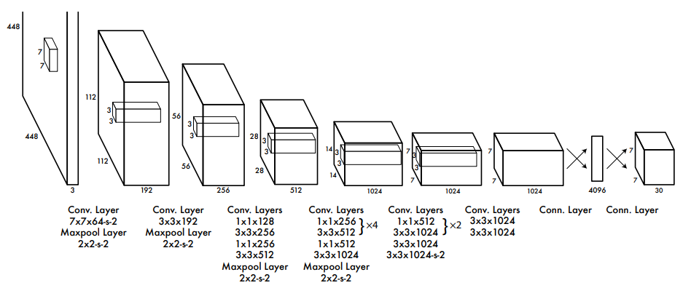
More about YOLO
Original YOLO: 24 conv. Layers, 7*7 grid, two boxes in each
YOLOv3: 106 convolutional layers, larger grid, more boxes
Source: Redmon, Joseph, et al. "You only look once: Unified, real-time object detection." Proceedings of the IEEE conference on computer vision and pattern recognition. 2016.
Notes:
Mohsen

Slide 19
Before COS598 (Frame-differencing)
Notes:
Mohsen

Slide 20
After COS598 (YOLO)
We were not able to capture footage with two fish, so we overlaid two clips on top of each other.
This causes a distribution shift (noise, color, etc.) compared to training data.
That would lower detection performance compared to an actual footage.
Notes:
Mohsen

Slide 21
Front/Top Views
Note: Top view was trained for only 5 epochs.
Notes:
Mohsen

Slide 22
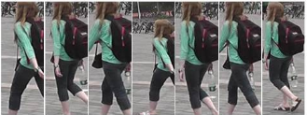
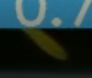
Adding tracking
Tracking and labeling fish with consistent IDs from frame to frame.
Association problem: assign each bounding box to an object ID.
SORT (2016) using intersection over union (IOU) of the bounding boxes.
DeepSORT (2017) uses a network to generate features for objects, and compares their “distance” using a special metric.
DeepSORT is pretrained on a dataset for people tracking and identification. Fish don’t have as many visual features as people.
We used SORT instead.
vs.
MARS: A Video Benchmark for Large-Scale Person Re-identification
Notes:
https://medium.com/@smallfishbigsea/notes-on-tracking-algorithms-sort-and-deepsort-d2684ced502f
Mohsen

Slide 23
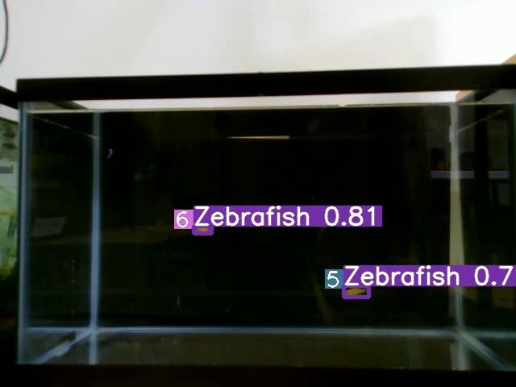
SORT Showcase
Detection loss, movement cause low intersection of bounding boxes -> SORT decides they are new objects.
Solution:
More training to minimize detection gaps. (with data augmentation to generate more examples of edge cases)
CVPR 2020 review paper: “None of the methods are able to track multiple zebrafish in 3D for more than a few seconds without ID swaps; this is still a difficult and unsolved problem.”
We believe we can easily do much better than “a few seconds” without ID swaps.
Notes:
Mohsen

Slide 24
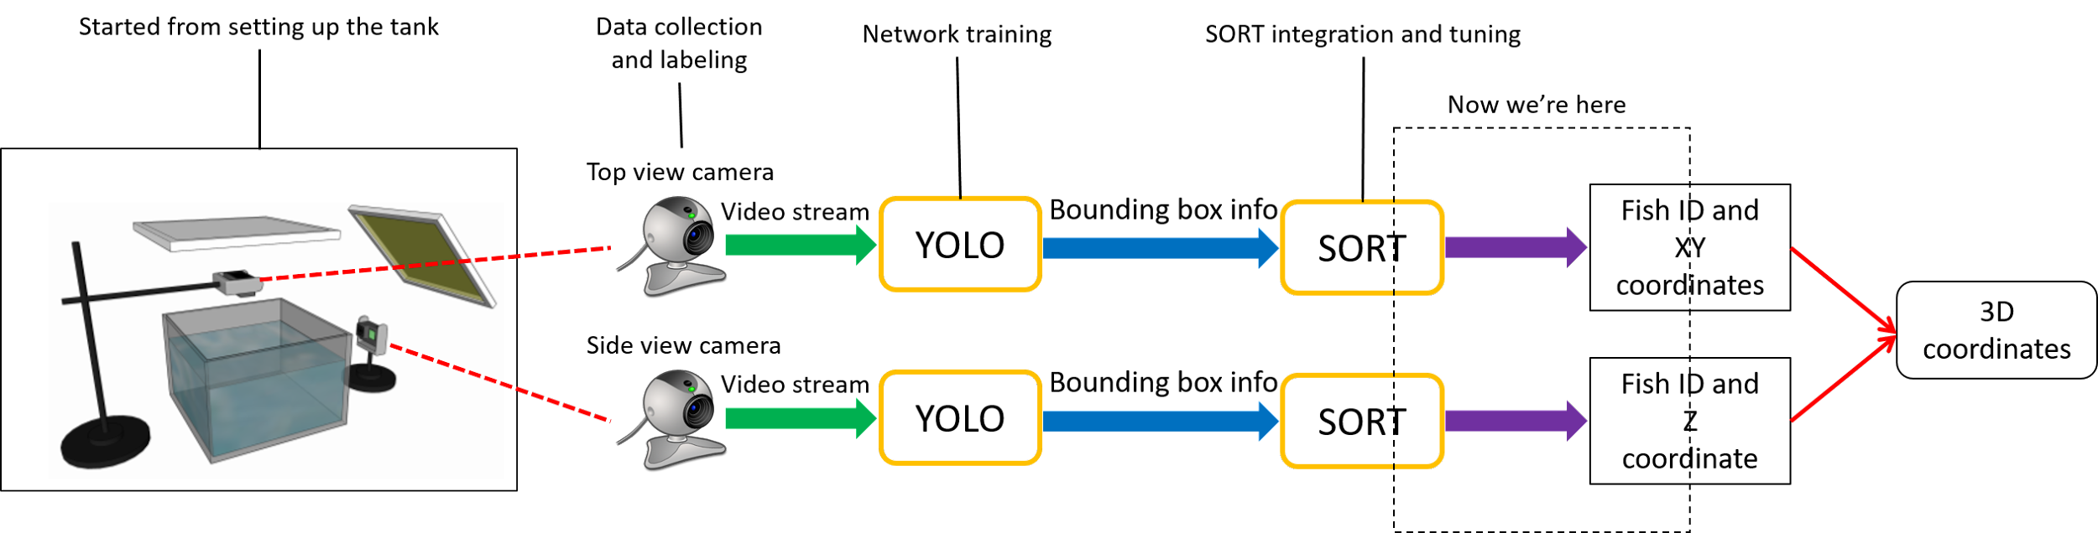
Progress Summary
Notes:
Mohsen

Slide 25
Future Applications / Improvements
Training to detect and track multiple type of fish
Virtual fish / Unity application
Fully automated system
Notes:
Matt

Slide 26
References and Credits
https://github.com/ultralytics/yolov3
Furthermore: https://pjreddie.com/darknet/yolo/
https://github.com/abewley/sort
Bewley, Alex, et al. "Simple online and realtime tracking." 2016 IEEE International Conference on Image Processing (ICIP). IEEE, 2016.
Wojke, Nicolai, Alex Bewley, and Dietrich Paulus. "Simple online and realtime tracking with a deep association metric." 2017 IEEE international conference on image processing (ICIP). IEEE, 2017.
Pedersen, Malte, et al. "3D-ZeF: A 3D Zebrafish Tracking Benchmark Dataset." Proceedings of the IEEE/CVF Conference on Computer Vision and Pattern Recognition. 2020.
Notes:
Mohsen

Slide 27
Questions?
Notes:
Matt

